Slide 1


Library Management System
GOALS AND OBJECTIVES FOR FISCAL YEAR 20XX REVIEW
Pallavi N

Slide 2
System Overview
Modules
Catalogue, Members, Circulations
Backend
Spring Boot
Frontend
Angular
Database
Relational database.

Slide 3
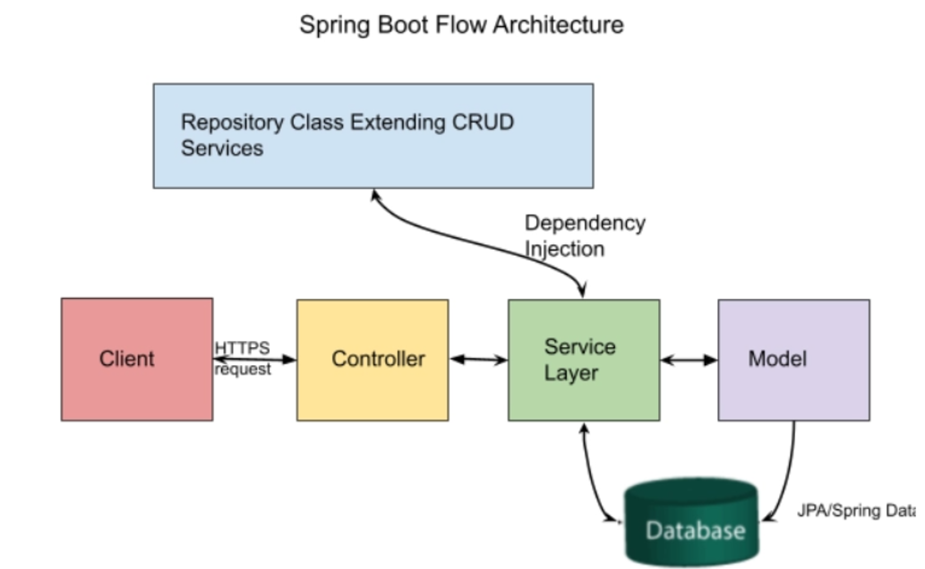



Use this space to highlight additional contextual info in a short, succinct way.
FULL NAME
TItle
FULL NAME
TItle
FULL NAME
TItle

Slide 4
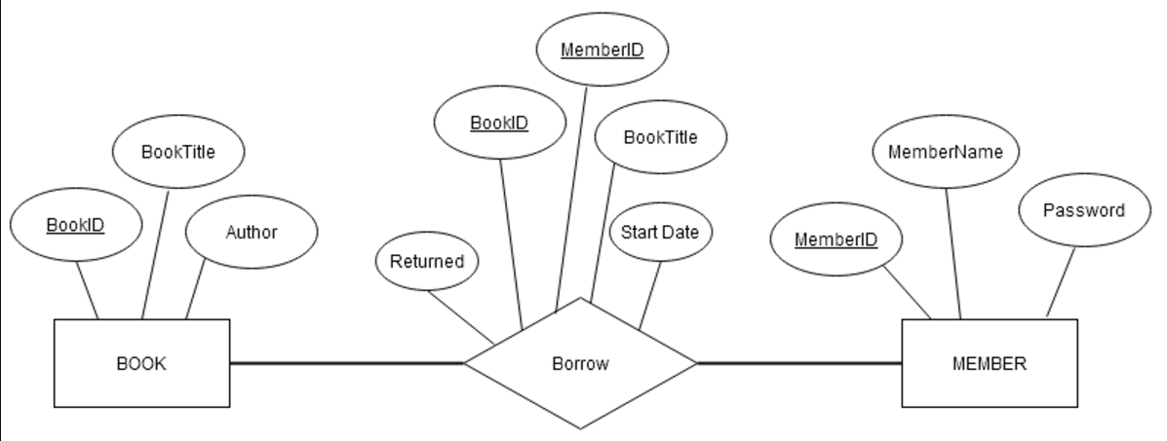


FISCAL YEAR 20XX
Mission
Catalogue

Slide 5


Use this space to highlight additional contextual info in a short, succinct way.
OWNERSj
private String generateCustomId() {
// Generate ID in the format CXXXX (e.g., C1234)
int randomNumber = (int) (Math.random() * 9000) + 1000; // Generate 4-digit random number
return "C" + randomNumber;
} For random Id
// Generate unique catalogue ID
private String generateCatalogueId() {
Catalogue lastCatalogue = catalogueRepository.findTopByOrderByIdDesc(); // Get last catalogue from DB
if (lastCatalogue == null) {
return "C0001"; // If no catalogues exist, start with C0001
}
String lastId = lastCatalogue.getId(); // Extract ID from the Catalogue entity
int lastNumber = Integer.parseInt(lastId.substring(1)); // Extract number from last ID
int nextNumber = lastNumber + 1; // Increment number
return "C" + String.format("%04d", nextNumber); // Return next catalogue ID in format "C0002"
} Generating id in sequence
FULL NAME
Title
FULL NAME
Title

Slide 6
Challenges Faced and Solutions
Issue: Unable to delete members due to foreign key constraints in circulation
Cascade delete using @OnDelete
Validate dependencies before deletion@Entity public class Member {
@OneToMany(mappedBy = "member", cascade = CascadeType.ALL)
@OnDelete(action = OnDeleteAction.CASCADE)
private Set<Circulation> circulations;

Slide 7

Longer headline with multiple lines of text
public void deleteMember(Long memberId) {
if (!circulationRepository.existsByMemberId(memberId)) {
memberRepository.deleteById(memberId);
} else {
throw new RuntimeException("Member is referenced in Circulation.");
K
key Features of Angular Frontend
Component-Based Structure
Dependency Injection and Two-Way Data Binding
Routing and Observables
Year over Year from 20XX

Slide 8


Takeaways:
Importance of database integrity and API validation
Importance of foreign key management
Future Improvements:
Adding features like pagination, JWT-based authentication,JPA security, and performance improvements,

Slide 9
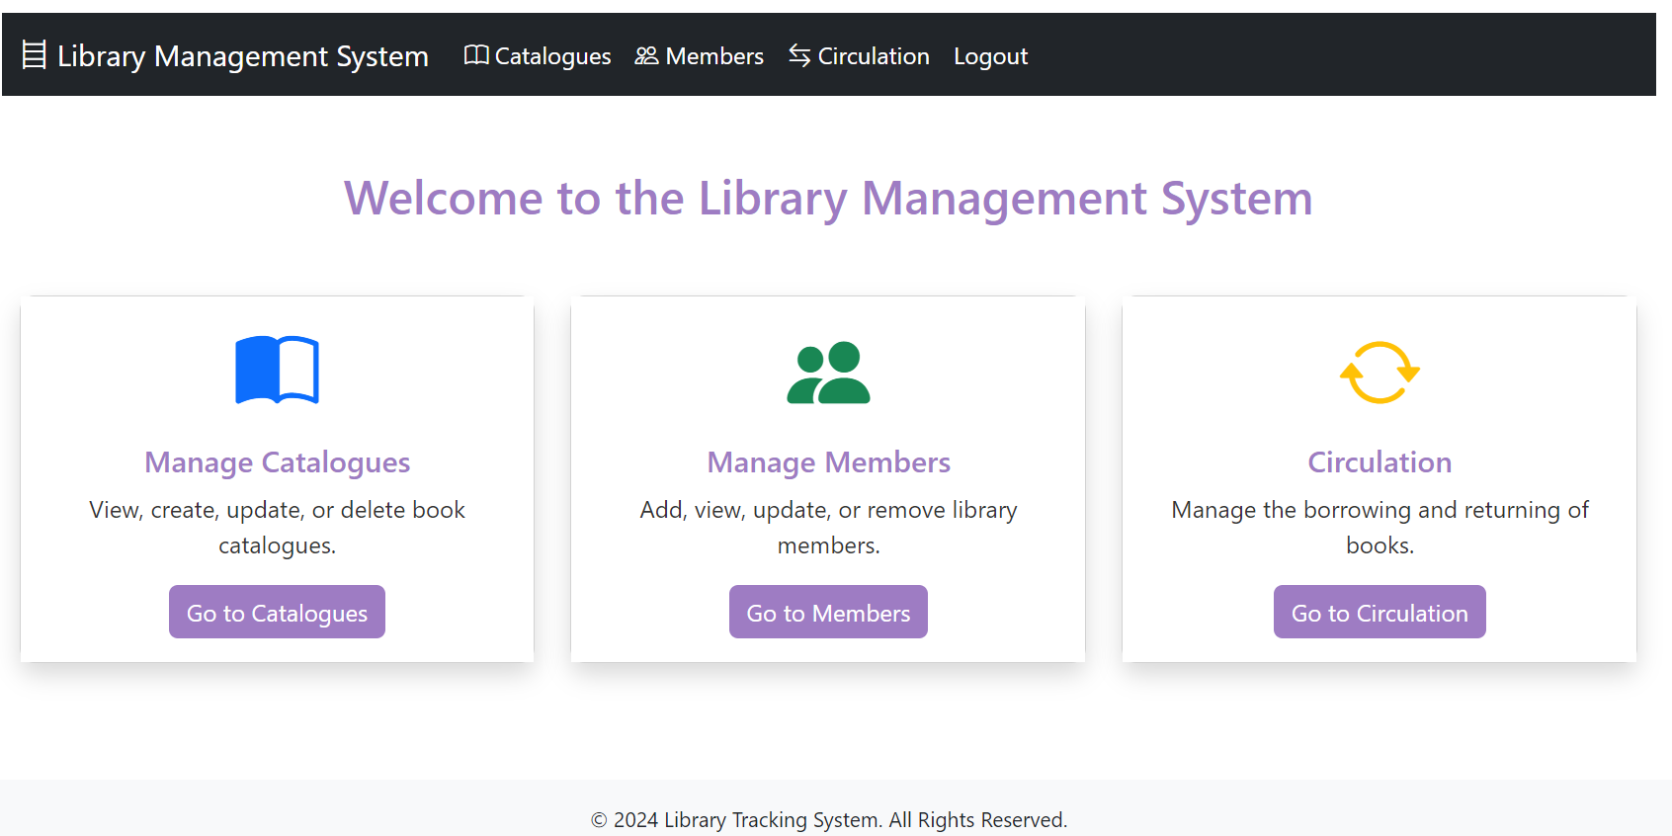

Slide 10
THANK
YOU

